Slide 1

UNIVERSITÉ ANTONINE
Faculté d’Ingénieurs en Informatique, Multimédias,
Réseaux et Télécommunications
Mabelle Tannoury
ID: 201110335
Zahlé 2017

Slide 2
Plan of the presentation
Purpose of creation of this project
Who can benefit of this website
Pages of the website
Importance of user experience
Functions and services of the website
Database used
Conclusion

Slide 3

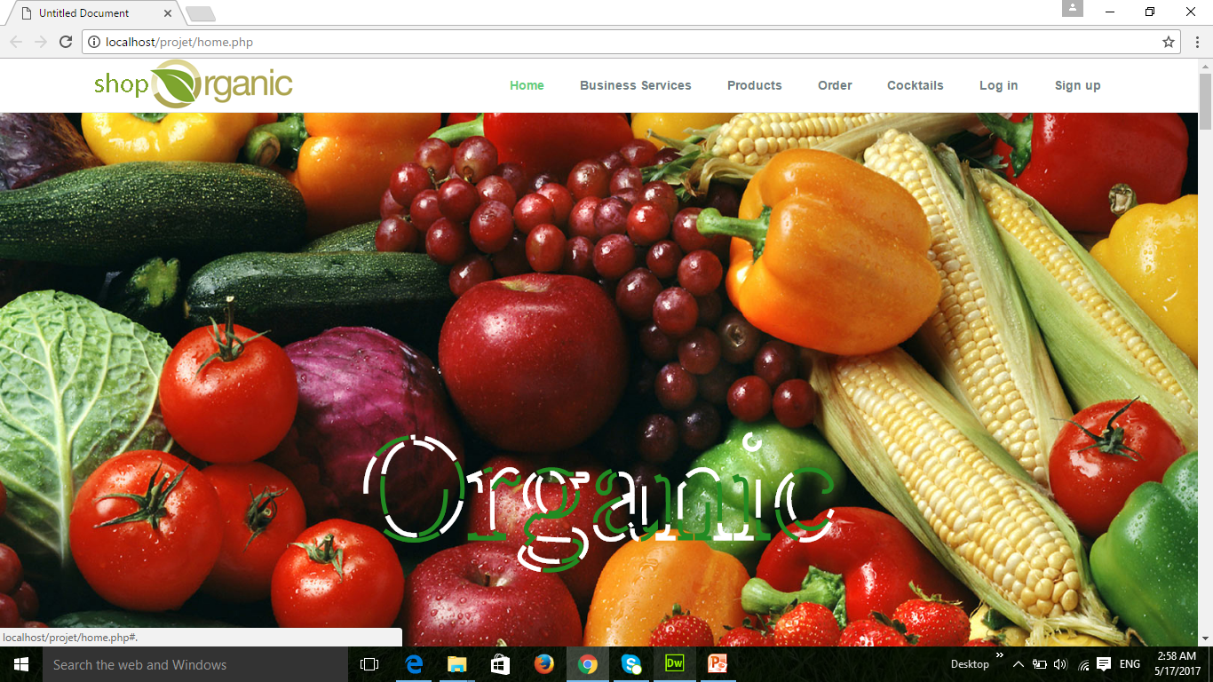
Logo and navigation bars

Slide 4
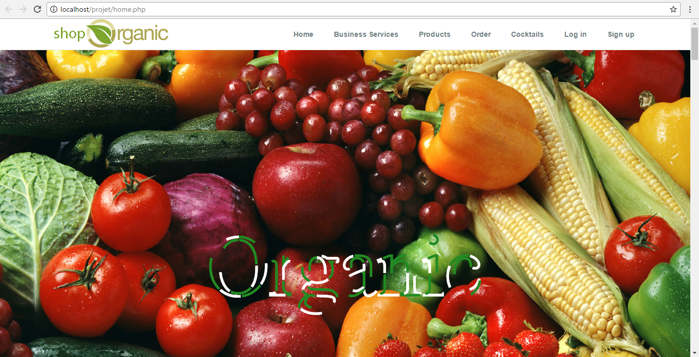
Home Page
The homepage must deliver the primary message quickly. An inviting homepage is the beginning of a great user experience.

Slide 5

Business Services page
How information is organized, structured, and presented to users.

Slide 6
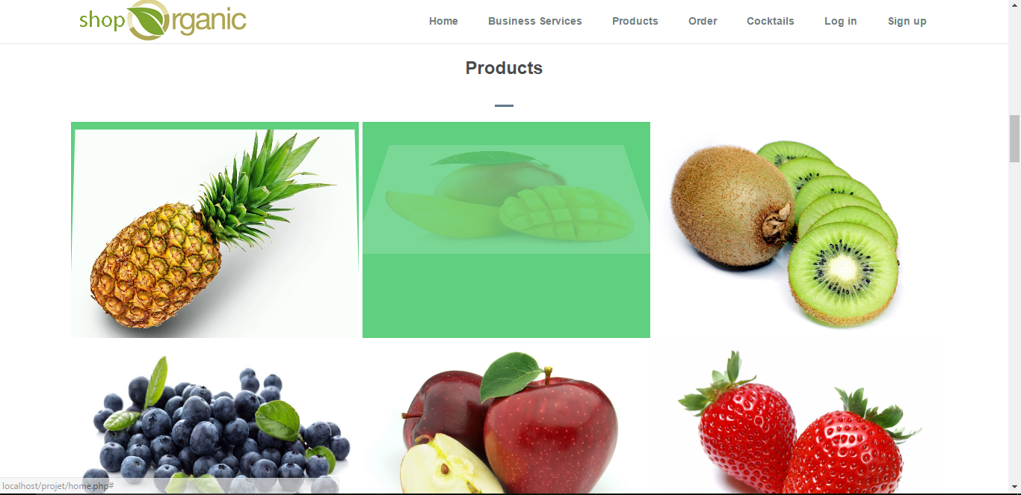
Products page
In this page we present our products by adding their pictures. When we mouse hover on each one the picture will rotate. So this will create an engaging interactive systems with the users.

Slide 7
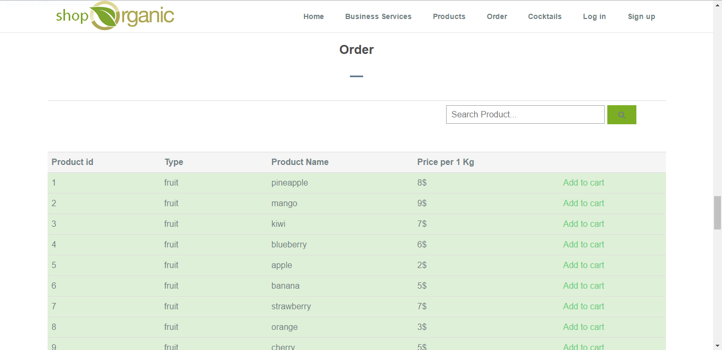
Order page
The user can order products and search a specific product to display its information.

Slide 8
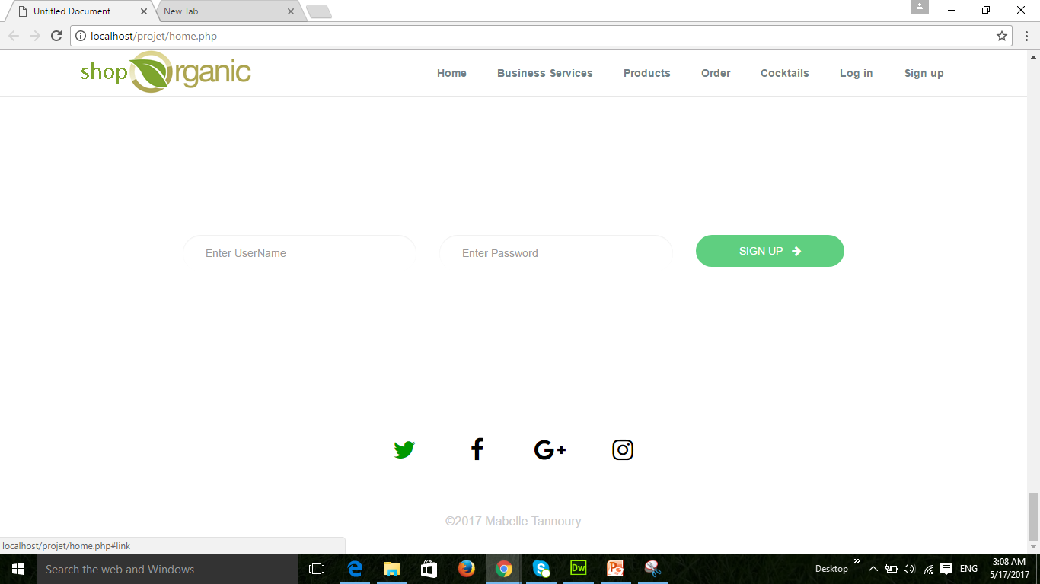
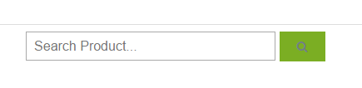
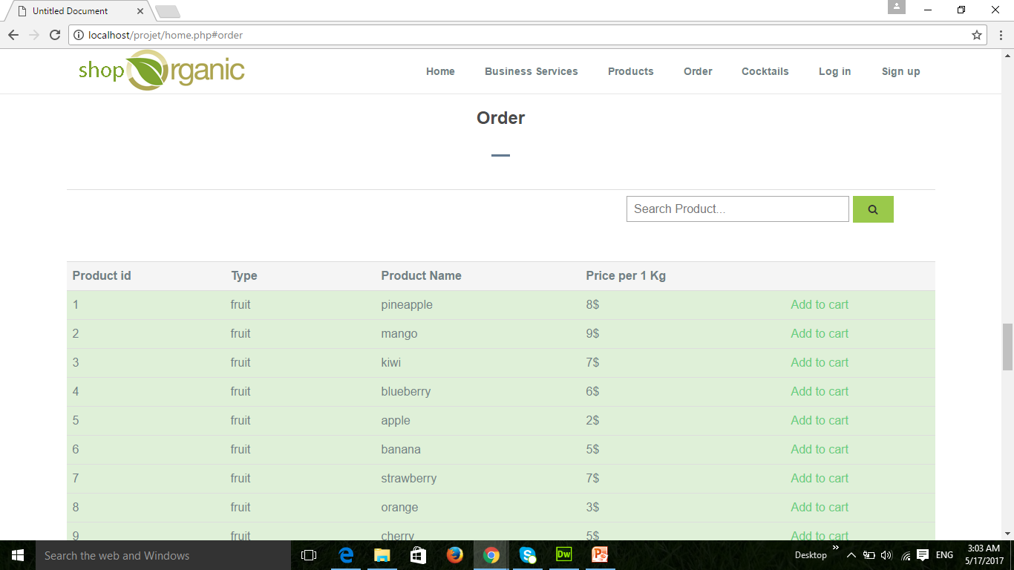

Slide 9
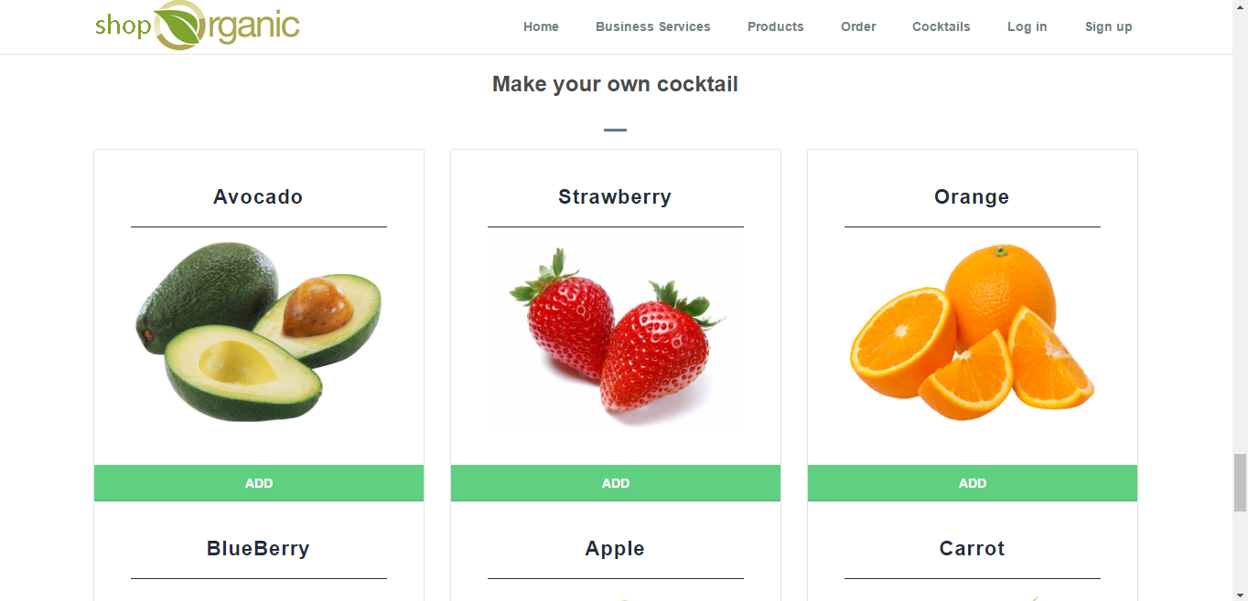
Cocktails page
The user can add items to make cocktails.

Slide 10
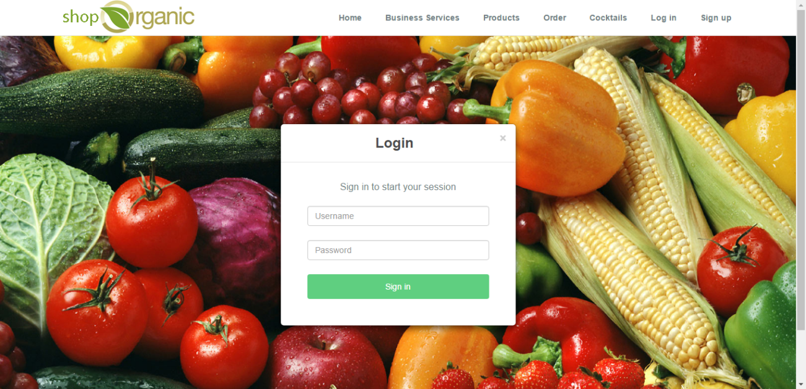

Log in and sign up pages

Slide 11
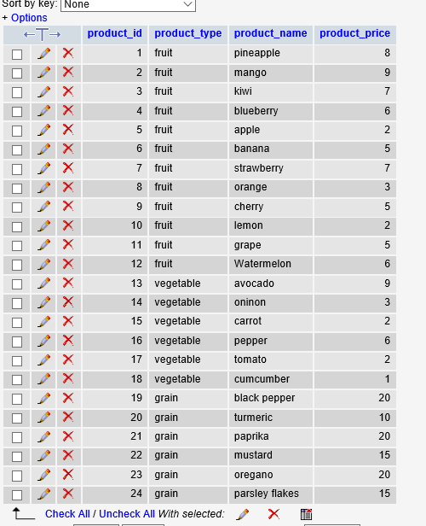
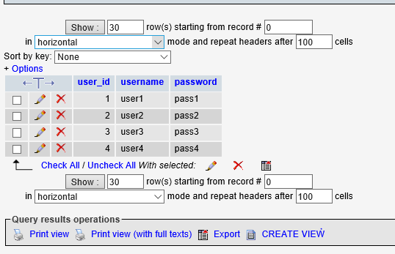
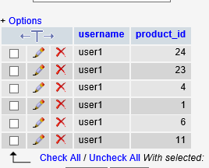
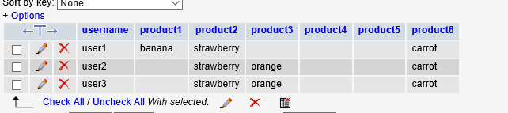
database

Slide 12
Conclusion
The best user experiences are built by effective design and clear copy. Keep it simple, be upfront and talk to the user.

